Slide 1

Government Cost Proposal Case Study: EagleShroud Tech Modernization
Rosaline Franklin
Pricing Analyst
May 23, 2025
Excel Pricing Model Workbook Overview
Portfolio Project

Slide 2
Project Overview
Objective: Modernize legacy systems for EagleShroud Tech to a cloud-native architecture
Contract Type: Time and Materials (T&M)
Period of Performance: 12 Months + 12 Option Months
Scope:
DevOps Engineering Support | Cloud Infrastructure & Security Automation | Agile Support & Technical Documenation | Other Direct Costs (ODCs)
CLIN-level pricing structure
Basis of Estimate (BOE) Narrative
Pricing Volume Narrative
My role: Full cost proposal development including Basis of Estimate (BOE), Excel Pricing Model, and Cost Volume Pricing Narrative

Slide 3
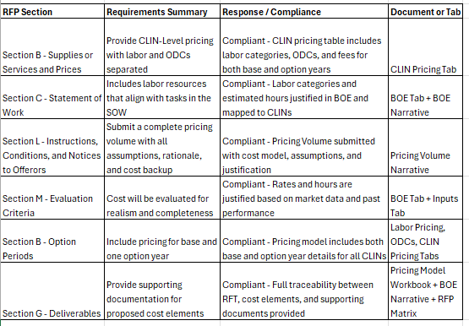
RFP Matrix
Outlines the different sections in the Request for Proposal (RFP)
Describes the different sections in more detail
During the life of the project the response/compliance column changes from working to compliant depending on completion of that section
Document column describes where the documentation can be found (either in the Pricing Model or in a different document in the project bundle.

Slide 4
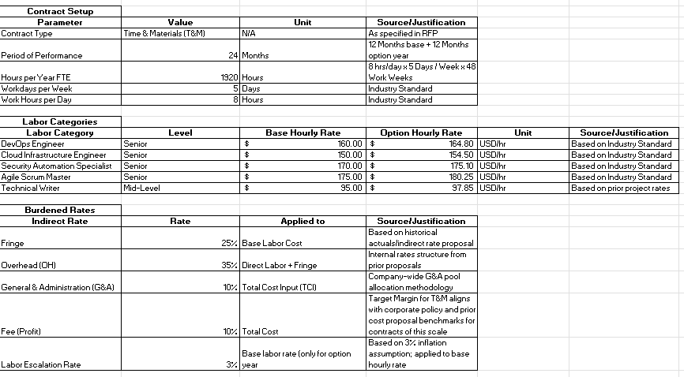
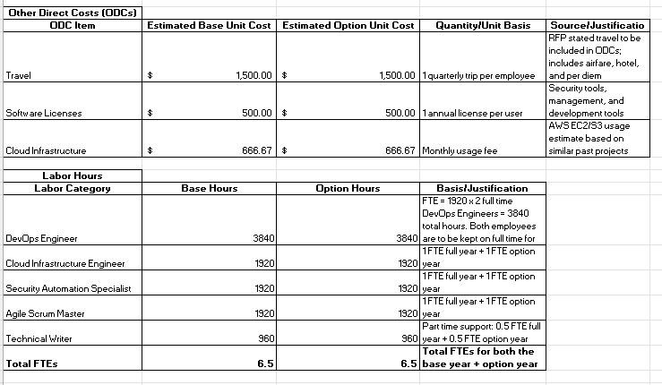
Inputs Tab
Contract is setup with Full Time Equivalent = 1,920 hours
Labor categories, labor hours, Other Direct Costs ODCs, and justifications are organized into tables
Burdened rates:
Fringe – 25%
Overhead(OH) – 35%
General & Administrative (G&A) – 10%
Fee (profit) – 10%
Labor Escalation Rate 3%

Slide 5
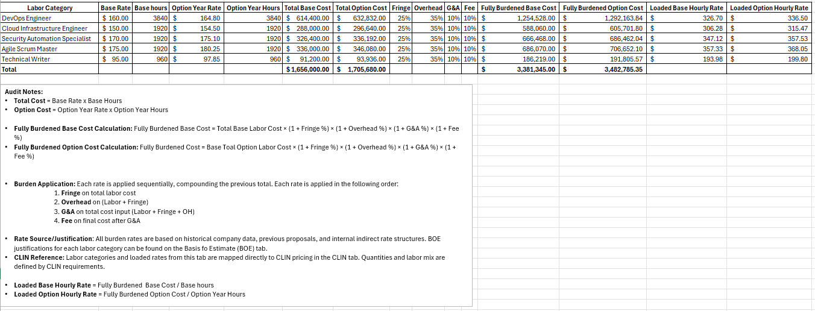
Labor Pricing Tab
List of labor categories: DevOps Engineer, Cloud Infrastructure Engineer, Security Automation specialist, etc.
Fully burdened Rate cost calculation:
Includes calculations for both base and option years
Audit ready with notes for justification and rate calculations
Total Fully Burdened Labor Cost for both base and option year = $6,867,130.35

Slide 6
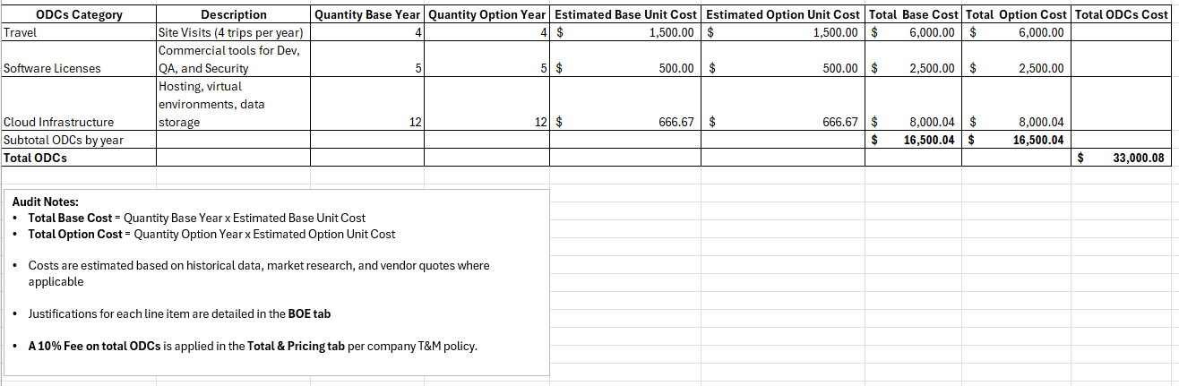
Other Direct Costs (ODCs)
Travel, software licenses, and cloud infrastructure all listed by quantity.
The estimated totals are broken down by base year and option year before the grand total.
Note the totals in this tab are not calculated with the fee – that is in the Total & Pricing tab.
Audit ready notes outlining Total Cost Calculation and justification reference.

Slide 7
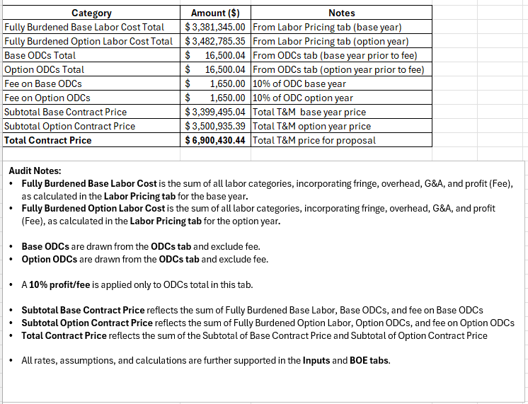
Total & Pricing
Total contract price = $6,900,430.44
This total combines the base year and option year.
A 10% fee is added at this point to avoid adding it multiple times by mistake.
Fully burdened base year and option year totals are calculated in the Labor Pricing tab and then referenced here.
Audit ready with notes outlining:
References to tabs pertaining to the calculation and justification of the pricing
A Breakdown of the fee applied to ODCs

Slide 8
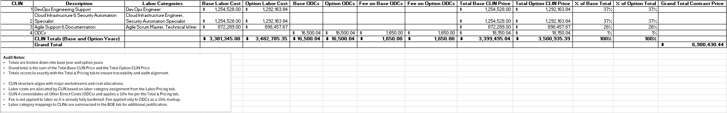
Contract Item Line Number (CLIN) – Level Pricing Tab
CLIN 0001: DevOps Engineering Support
CLIN 0002: Cloud Infrastructure and Security Automation
CLIN 0003: Agile Support and Technical Documentation
CLIN 0004: ODCs
Audit ready with notes outlining:
CLIN structure
Fee structure
References to important tabs

Slide 9
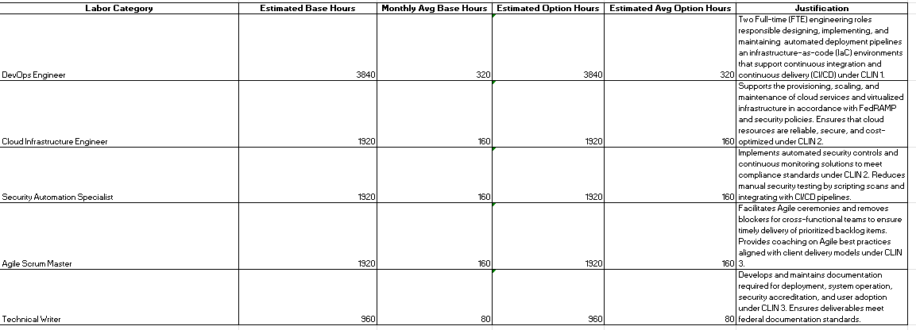
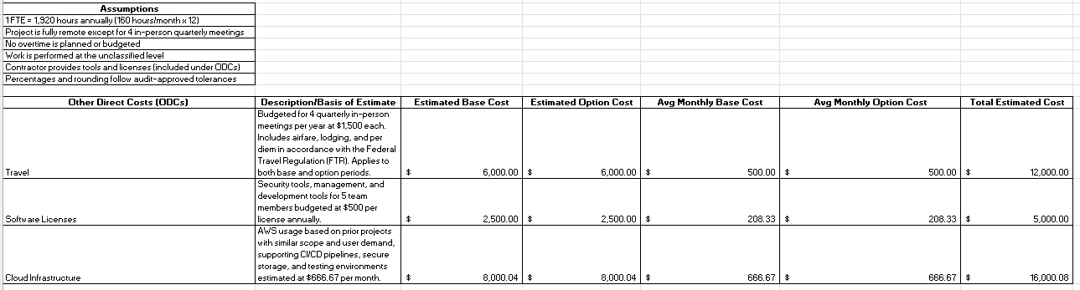
Basis of Estimate (BOE)
Justifications for:
Labor categories
hours selected
Assumptions
ODCs (with associated cost)

Slide 10

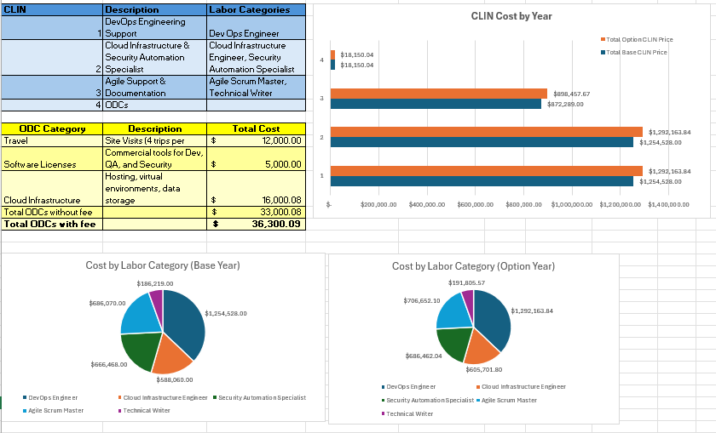
Dashboard Tab
Visuals for:
CLIN Table
CLIN Labor Cost by Year
ODC Table
Labor Cost by Category by Year
KPI cards summarizing key components of the cost proposal

Slide 11
Key Takeaways
The different tabs in this Pricing Model Workbook supported the creation of my cost volume and my basis of estimate.
Skills shown in this project:
Government pricing model development
Cost estimation and proposal writing
Taking a Request For Proposal (RFP) and using it as a basis for my proposal
Referencing my RFP to different documents via RFP Matrix
Excel modeling (burden rates, summaries, dashboards
Federal contract compliance awareness

